Slide 1
Tranquilitea
Ashley Vargas, Karina Vargas, Christina Cueno & Rachel Lau

Slide 2
What is Tranqulitea?
A click and drag game where the player starts with a few base ingredients that you can mix to create teas, but only some combinations work. When you combine an accurate combination and brew, the new tea gets added to a recipe book.

Slide 3
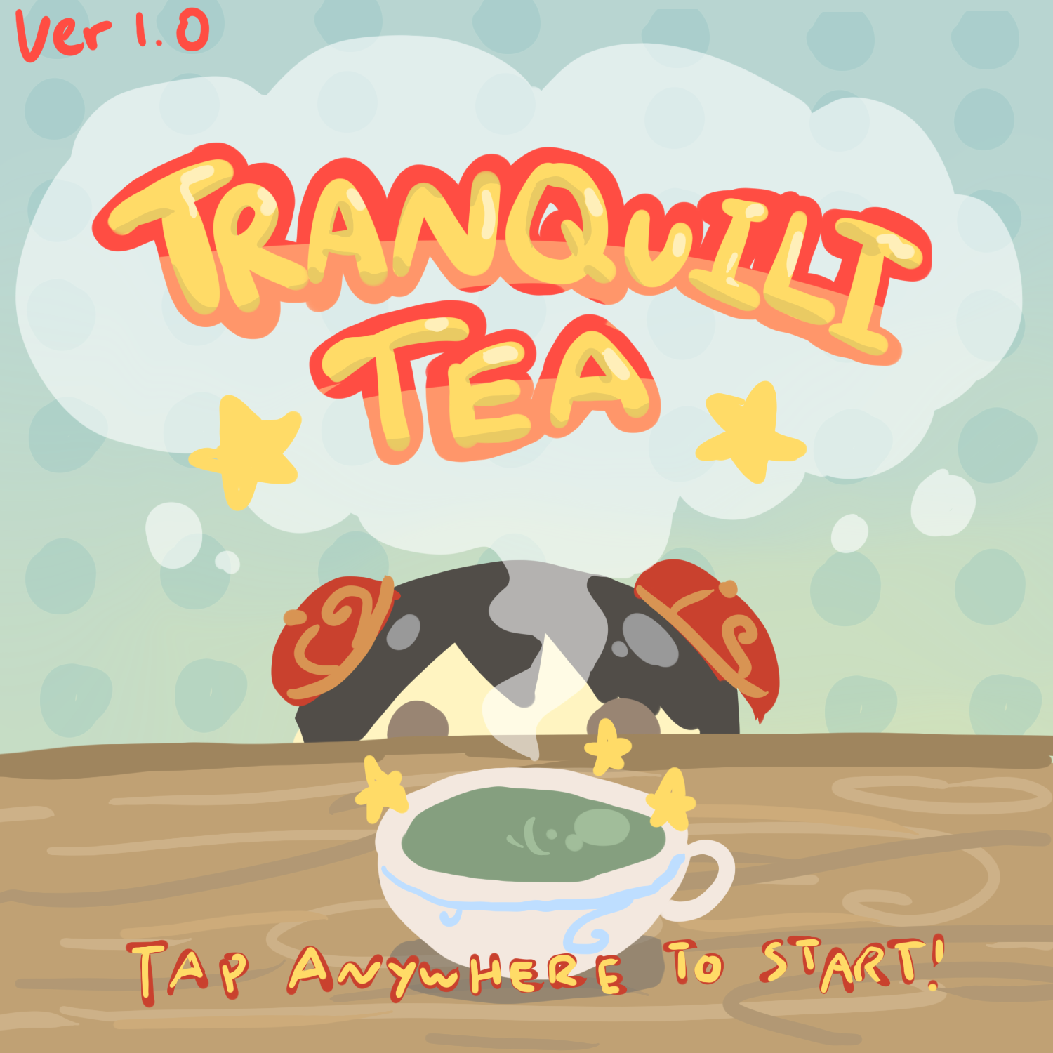
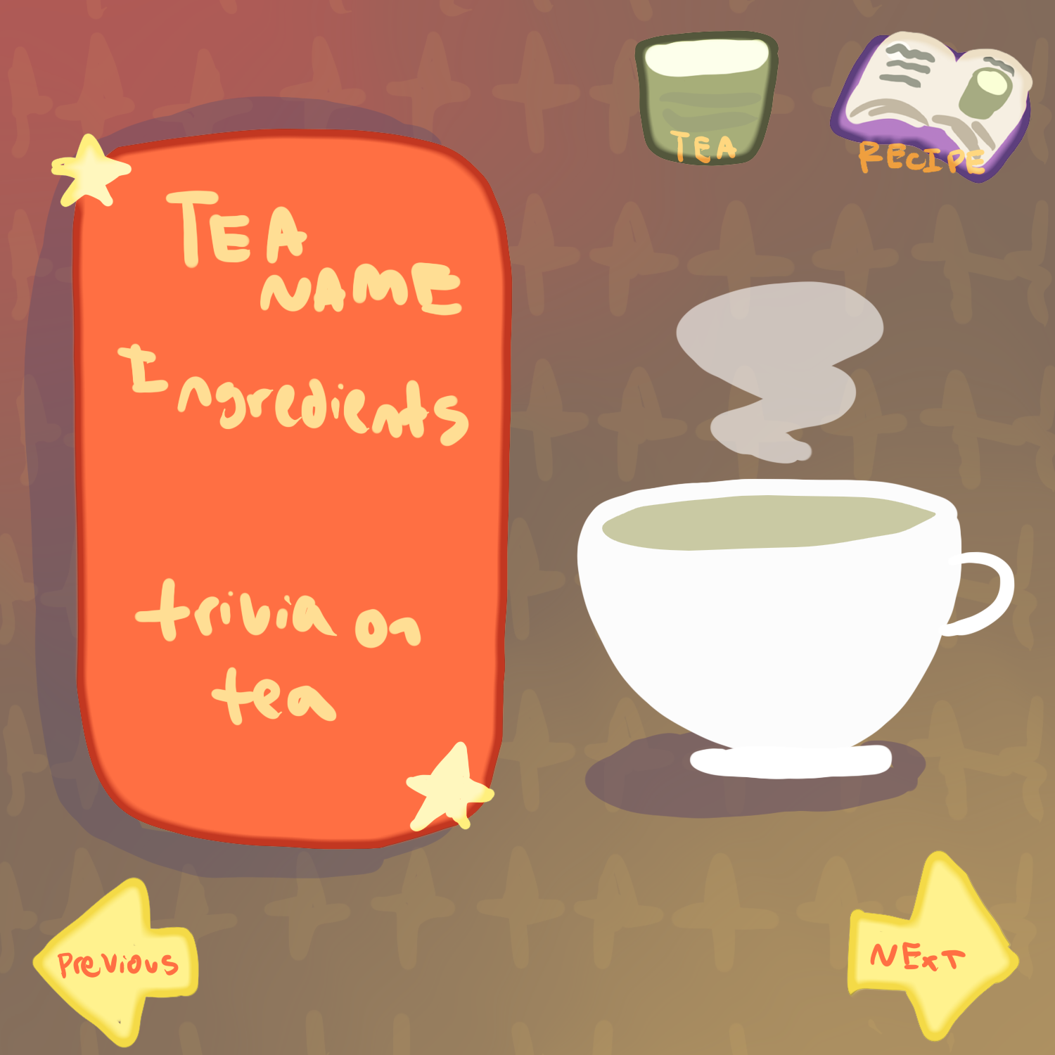
Original sample arts for our app.

Slide 4
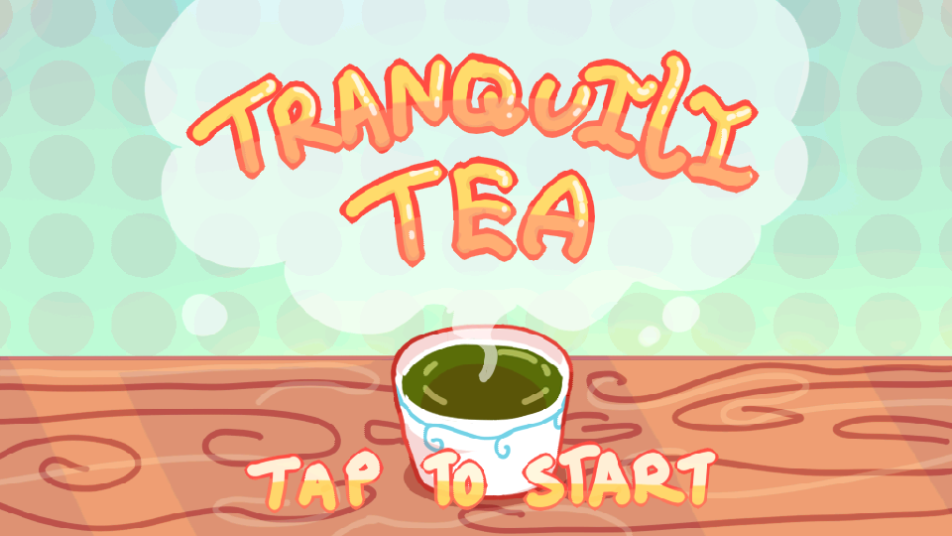
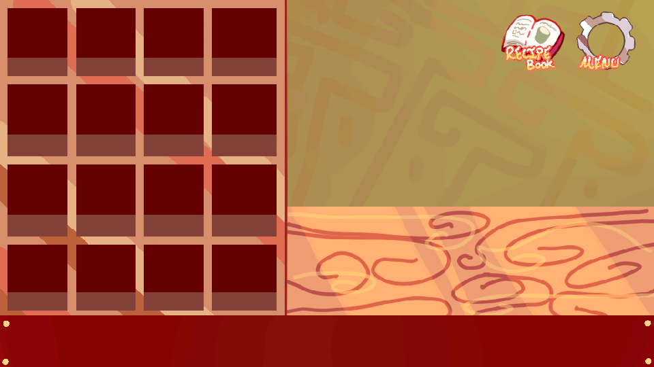
Screenshots

Slide 5

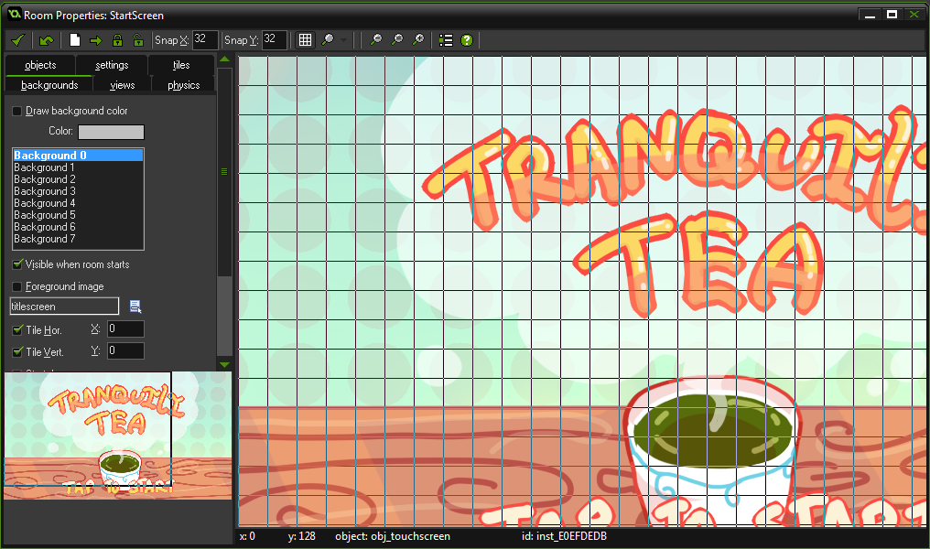
Screenshots continued

Slide 6

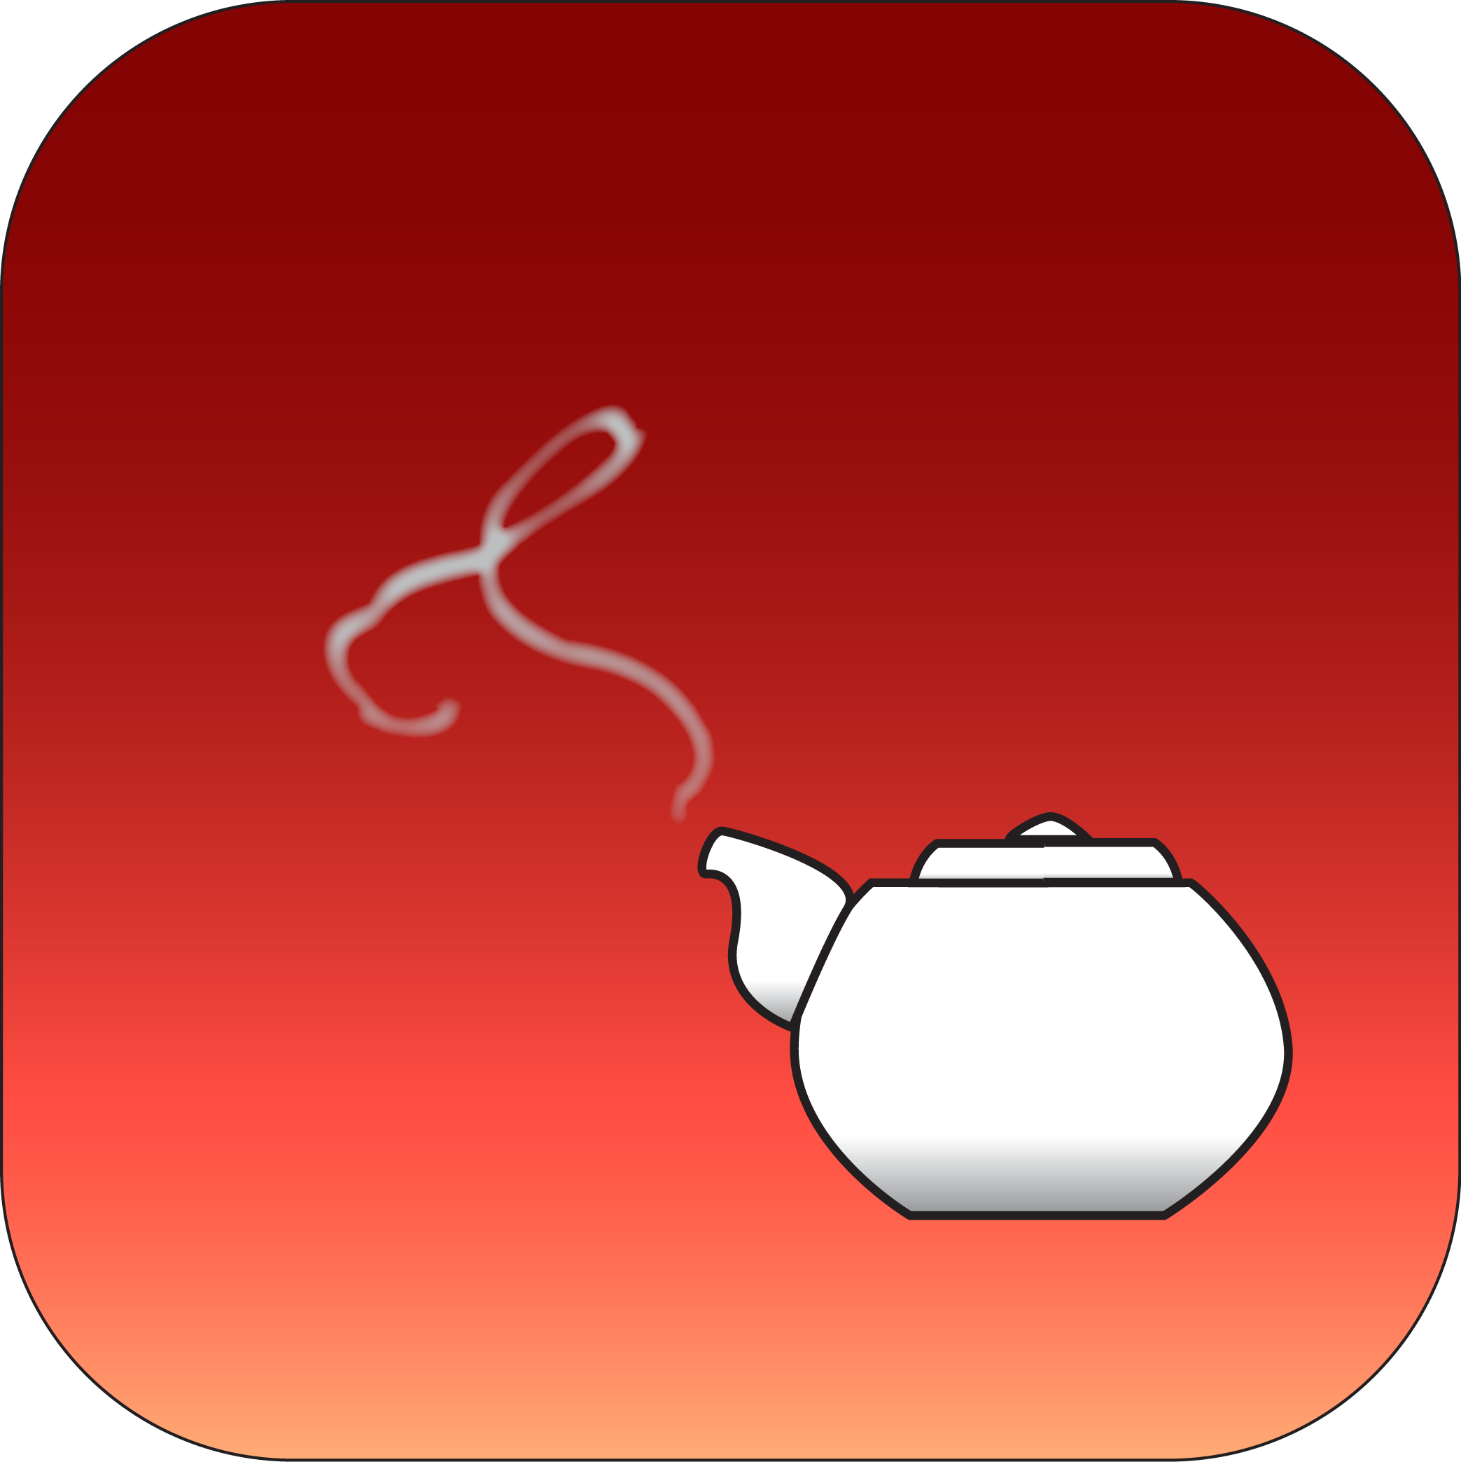
Icon ideas

Slide 7
Tranquilitea Live Test Run

Slide 8

Video

